Slide 1
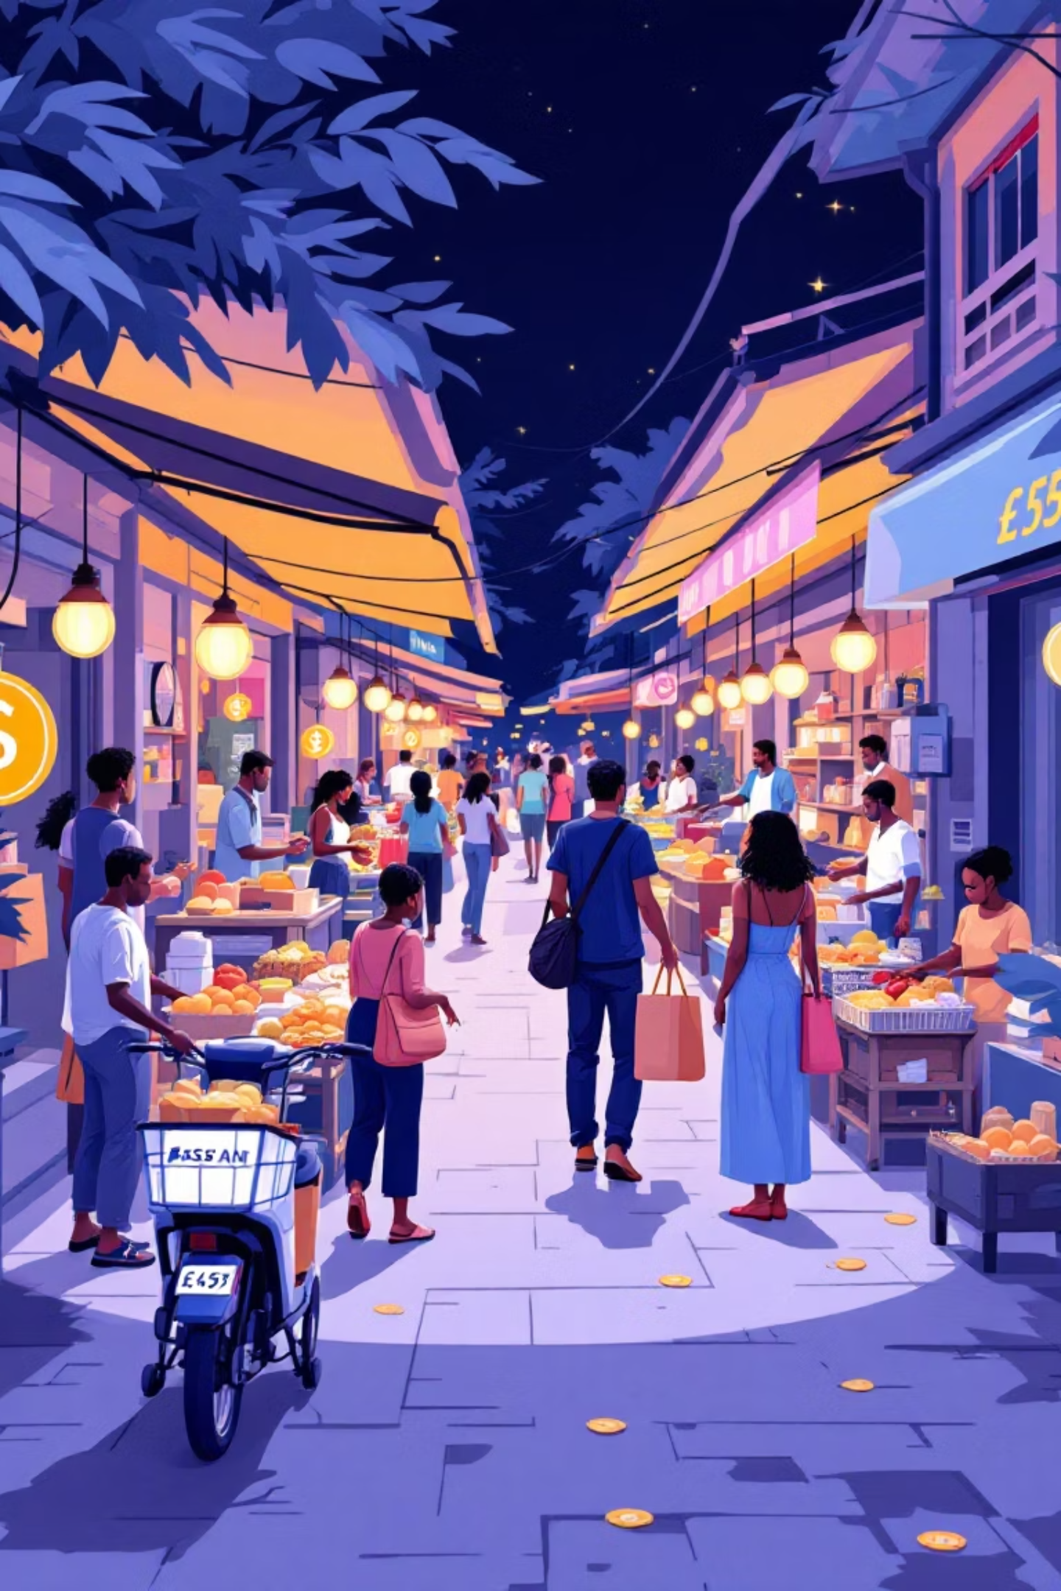

Strengthening Ghana's Tax System Through Digitalization
Ghana aims to boost national development by improving domestic revenue mobilization. A major challenge is widening the tax net, especially within the large informal sector. Digitalization, backed by strong education, is key to achieving this goal and funding public services sustainably.

Slide 2
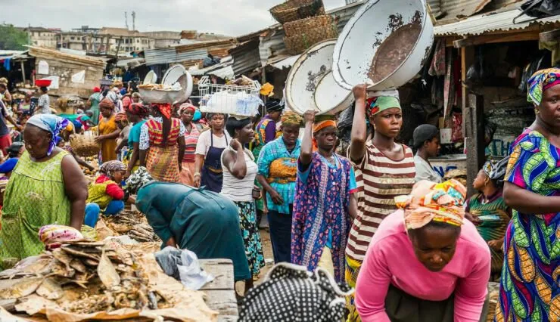
The Informal Sector Challenge
Many artisans, traders, and small-scale entrepreneurs operate outside formal tax structures. This contributes to a low tax-to-GDP ratio, limiting government funding for public services and infrastructure.
Digital tools can simplify registration and compliance, but without clear education, many may resist or not fully appreciate their benefits.

Slide 3

Education: The Foundation of Trust
1
2
3
Understanding Obligations
Using Digital Tools
Bridging the Gap
Helps informal and formal workers understand tax obligations and benefits of compliance.
Empowers citizens to confidently use new digital tools provided by the Ghana Revenue Authority (GRA).
Ensures digitalization truly boosts tax compliance and supports national development.

Slide 4




Digital Education Framework
Ghana needs a robust digital education framework aligned with legal mandates, revenue goals, and technological realities. Digital tools alone are insufficient; many taxpayers lack digital literacy. A well-crafted strategy builds trust and compliance.
Digital Awareness
Digital Literacy Training
Inform about platforms and processes.
Develop skills to use digital tax tools.
Local Language Accessibility
Partnerships
Overcome language barriers for broader adoption.
Collaborate with stakeholders for wider reach.

Slide 5




Key Pillars of Digital Education
SMS Alerts & Reminders
Online Tutorials & Videos
Short, clear messages in local languages for deadlines and payments.
Visual guides on registration, filing, and digital payments.
Cybersecurity Training
Community Digital Centers
Teach safe password habits and fraud detection.
Mobile hubs with internet and facilitators for hands-on help.

Slide 6
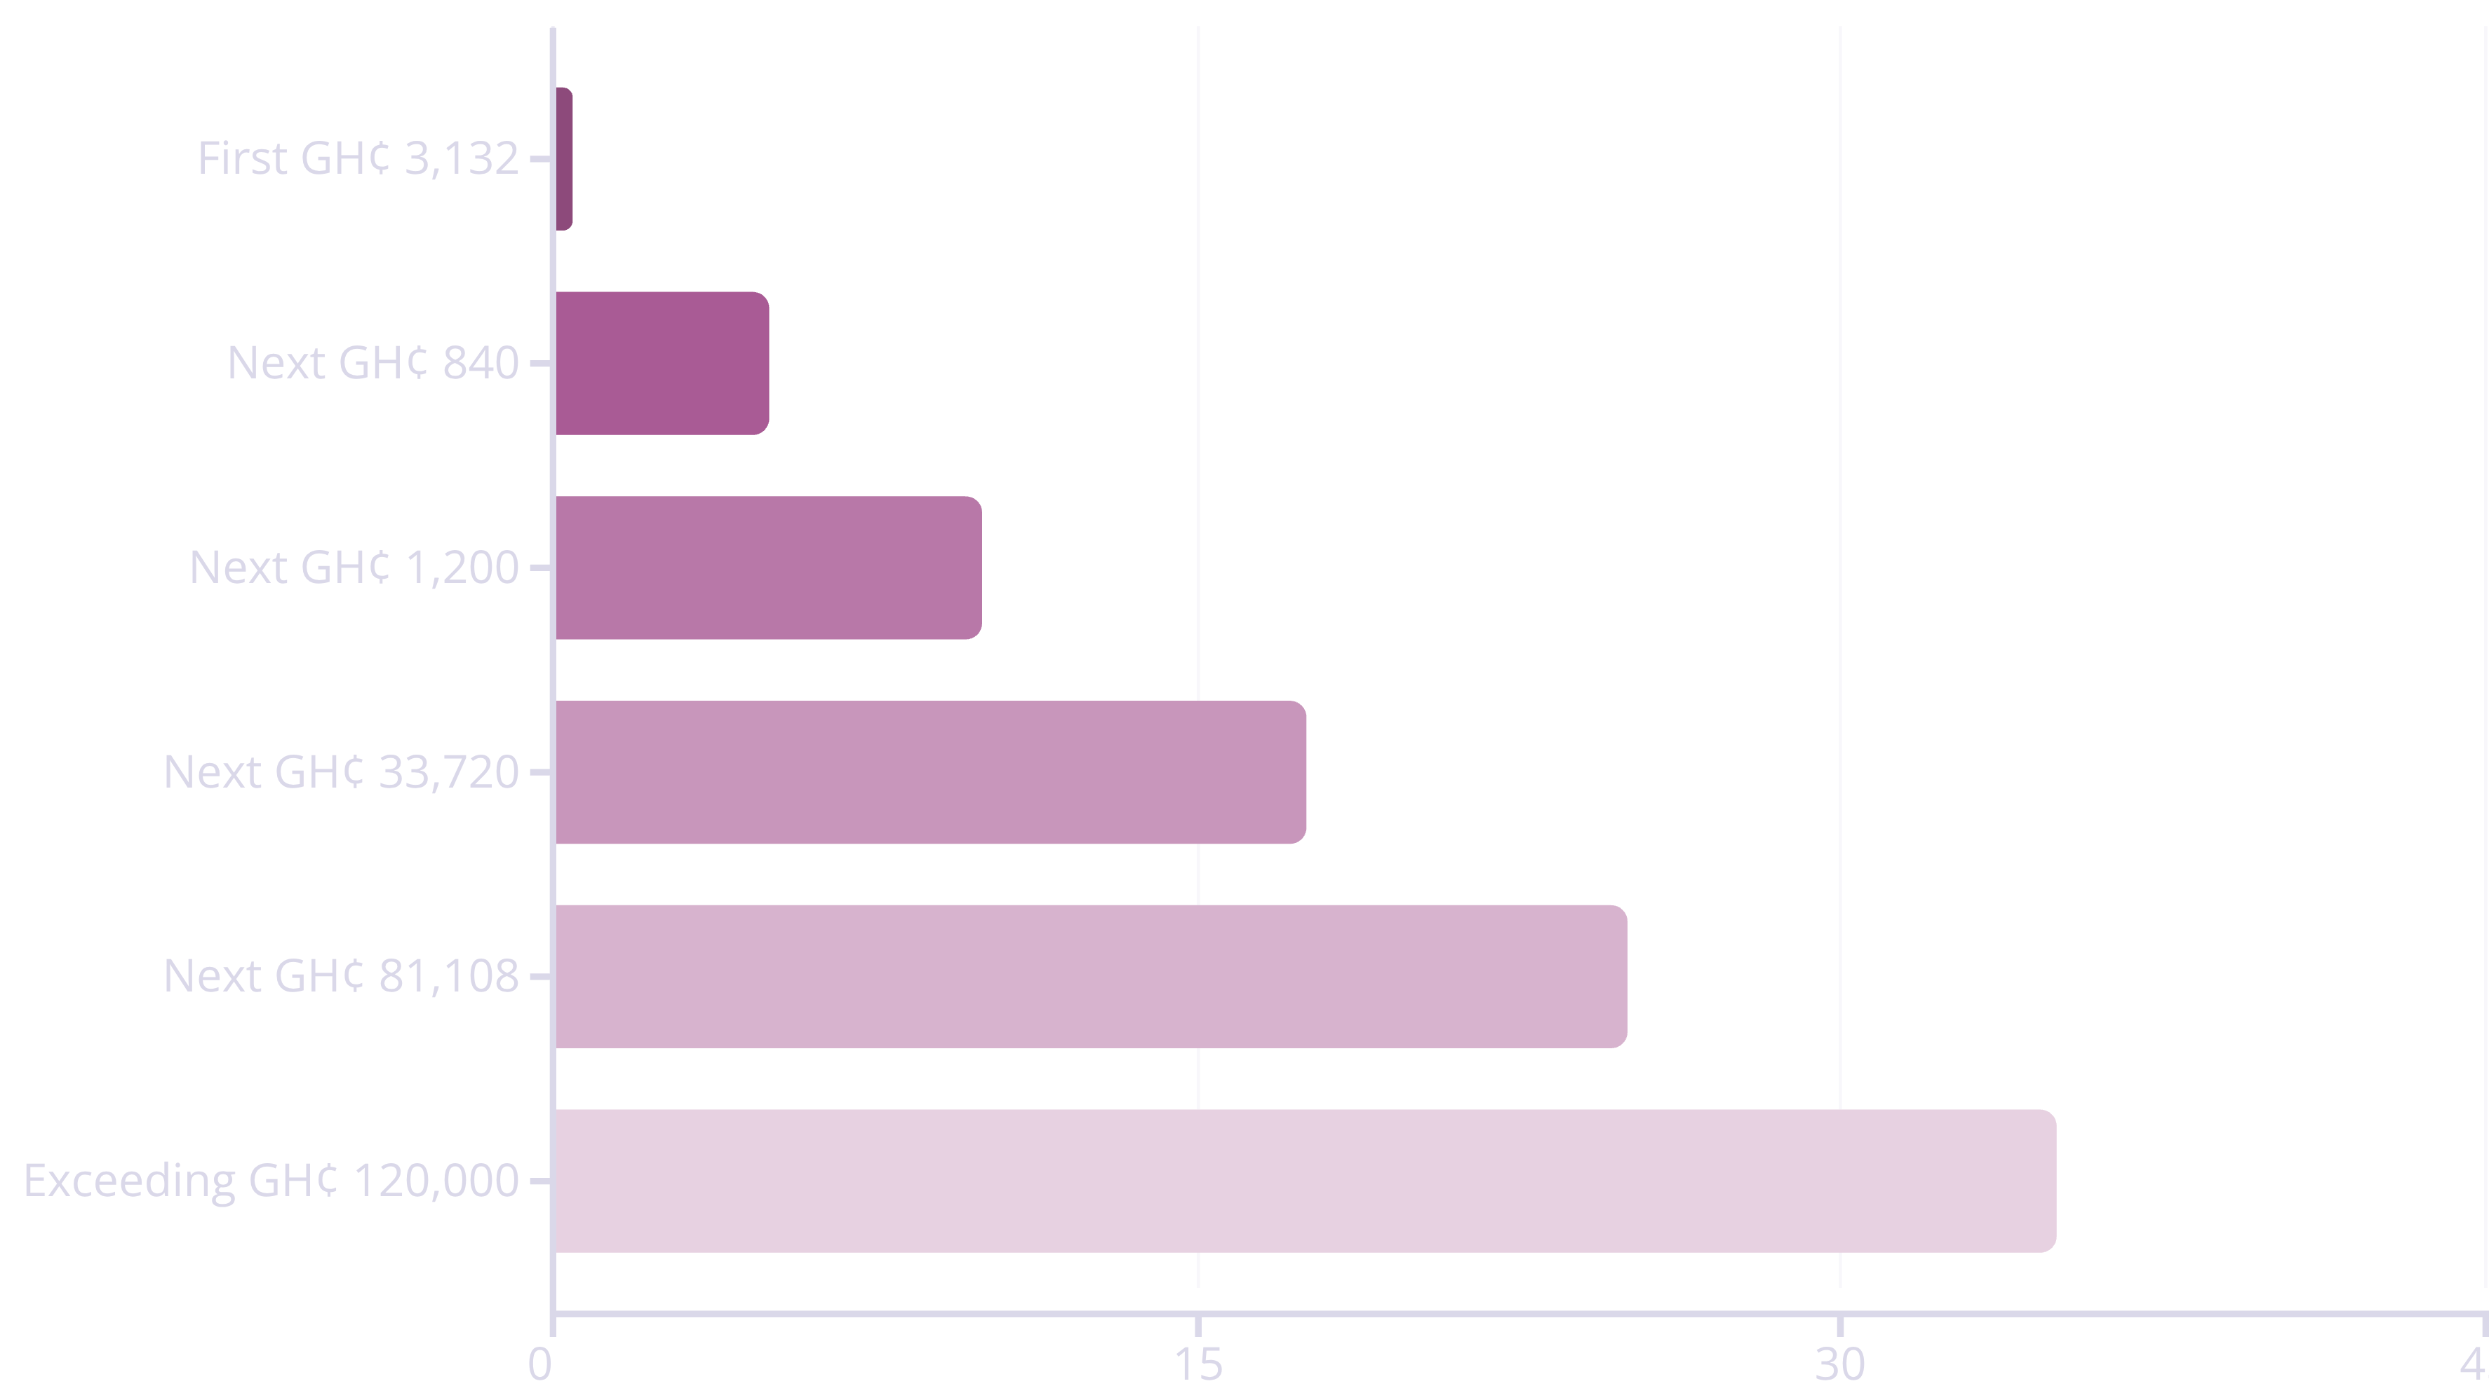
Ghana's Tax Framework
Understanding the legal foundation: Income Tax Act, Act 896 establishes clear tax obligations for all earners.
Many informal workers earn above the threshold but remain outside the system due to lack of tracking mechanisms.

Slide 7
Resident Individual Tax Rates
1
First GH¢ 3,132
0% (Nil)
2
Next GH¢ 840
5%
3
Next GH¢ 1,200
10%
4
Next GH¢ 33,720
17.5%
5
Next GH¢ 81,108
25%
6
Exceeding GH¢ 120,000
35%
Source: Income Tax (Amendment) Act, 2018 (Act 973)

Slide 8



New Taxation Model: Digitalizing Payments
The digitalization plan aims to reduce physical cash and encourage mobile-money payments, making financial flows more transparent and easier to tax. A "2 cedis, 20 pesewas" prototype is introduced.
Short Code Payments
Deterring Avoidance
Fractional Reserve Banking
Sender pays 20 pesewas, receiver pays full tax on money received.
Personal transfers incur a 2 cedis charge, encouraging short code use.
Supports a debt-based banking system, making digital money flow faster and safer.

Slide 9



Process of the New Taxation Model
USSD Registration
Easy mobile registration for all, including informal workers.
Link Ghana Card to TIN
Connects identity to tax system for easier tracking.
National Tax Registry
Accurate records for individuals and businesses.
Online Licensing
Apply/renew licenses online, reducing physical office visits.
Reduce Cashflow
Electronic payments reduce leakage and corruption.
Network Provider Takes Tax
Telecoms automatically apply and submit taxes to GRA.
Non-Compliance
Penalties for refusal to register or pay taxes.

Slide 10

Strengthening Ghana's Future
A digital-first tax system, supported by strong education, user-friendly tools, and strategic partnerships, can widen the tax net, boost development funds, and build a fair system where everyone contributes their share for a prosperous Ghana.

